Slide 1

State of the States 2013
Connect the Dots
Using evaluations of teacher effectiveness
to inform policy and practice
National Council on Teacher Quality

Slide 2
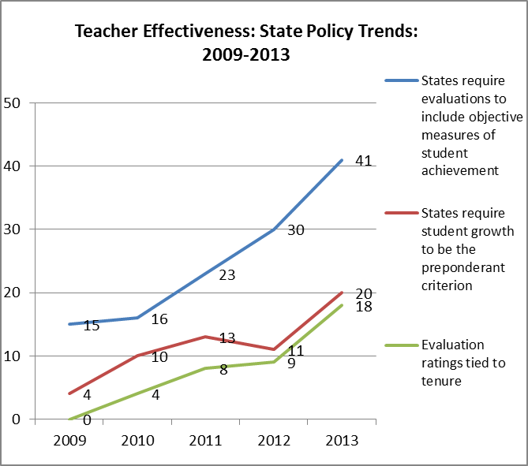

Slide 3
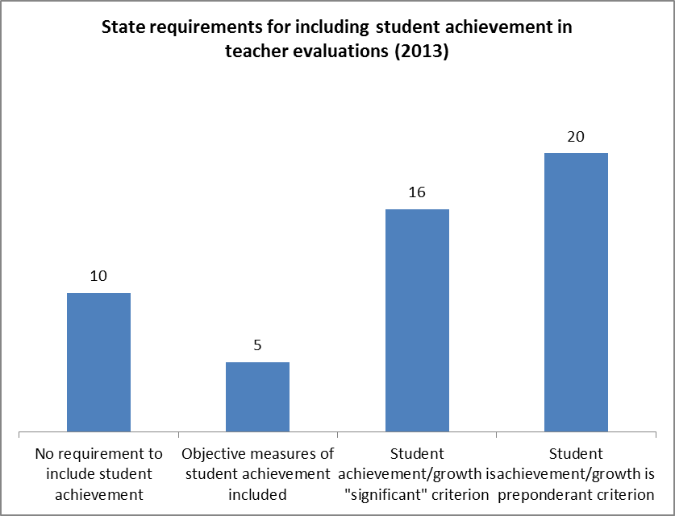

Slide 7
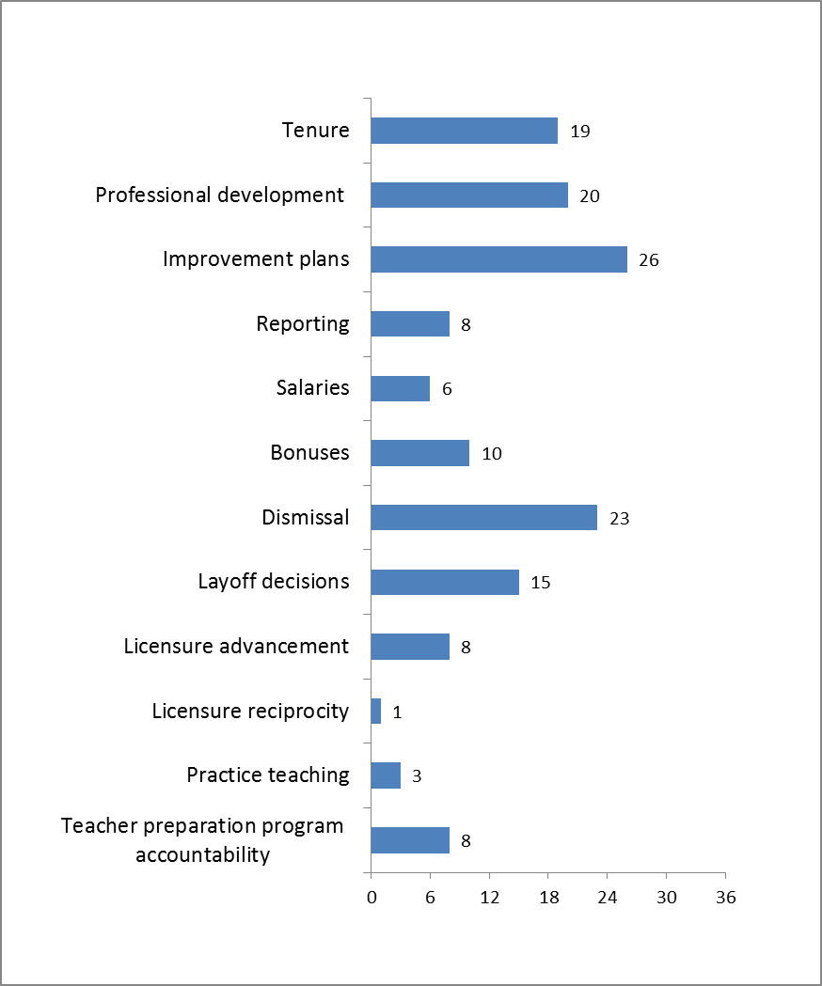

State policy connections between evaluation and:

Slide 8
Lessons and Recommendations
States must to connect the dots. Overhauling evaluation systems is expensive and time-consuming work – not using the results in meaningful ways is counterproductive and wasteful.
Differentiating teacher performance isn’t going to happen just because states and districts have a new evaluation rubric.

Slide 9
Lessons and Recommendations
All teachers need feedback – not just low-performers.
The Common Core should not be used as an argument for suspending teacher evaluations.
Special education and non-tested grades and subjects cannot be an afterthought.

Slide 10
Lessons and Recommendations
While there is a place for collective responsibility for school performance, school wide measures cannot be a substitute for individual measures of performance.
States need to require and implement measures that they can demonstrate correlate with student achievement – not allow teacher evaluation to become a watered-down process.

