Slide 1


Implementing the Common Core and PARCC Assessments
Michael Cohen
February 15, 2012

Slide 2
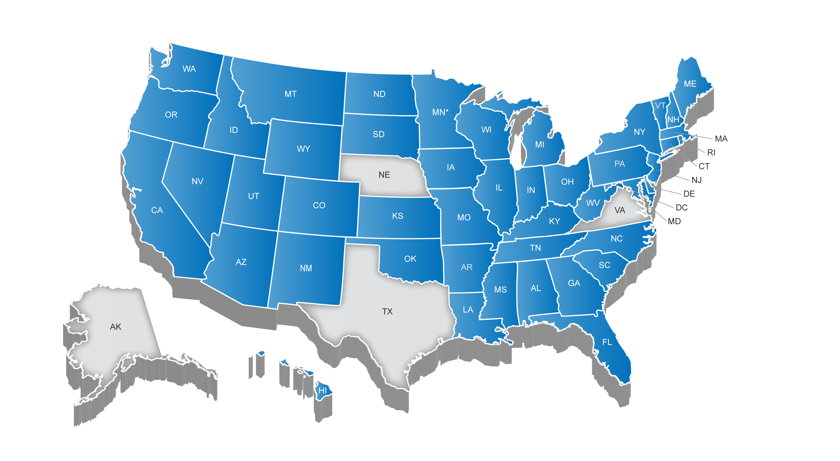

46 States + DC Have Adopted the
Common Core State Standards
* Minnesota adopted the CCSS in ELA only

Slide 3
Key Advances of the Common Core in Mathematics
MATHEMATICS
Focus, coherence and clarity: emphasis on key topics at each grade level and coherent progression across grades
Balance between procedural fluency and conceptual understanding
Promote rigor through mathematical practices that foster reasoning and application across discipline
ANCHORED IN COLLEGE AND CAREER READINESS

Slide 4
Focus in Mathematics Providing Greater Depth
Grade | Priorities in Support of Rich Instruction and Expectations of Fluency and Conceptual Understanding
K-2 | Addition and subtraction--concepts, skills, and problem solving
3-5 | Multiplication and division of whole numbers and fractions – concepts, skills, and problem solving
6 | Ratios and proportional relationships; early expressions and equations
7 | Ratios and proportional relationships; arithmetic of rational numbers
8 | Linear algebra

Slide 5
  MATHEMATICAL PRACTICES
Mathematically proficient students:
Make sense of problems and persevere in solving them
Reason abstractly and quantitatively
Construct viable arguments and critique the reasoning of others
Model with mathematics
Use appropriate tools strategically
Attend to precision
Look for and make use of structure
Look for and express regularity in repeated reasoning

Slide 6
Key Advances of the Common Core in ELA/Literacy
ENGLISH LANGUAGE ARTS/LITERACY
Balance of literature and informational texts; focus on text complexity
Emphasis on argument, informative/ explanatory writing, and research
Literacy standards for history, science and technical subjects
ANCHORED IN COLLEGE AND CAREER READINESS

Slide 7
Non-Text Dependent vs. Text Dependent Questions
  Examples from a lesson on Lincoln’s Gettysburg Address
Non-Text Dependent Questions | Text Dependent Questions
Have you ever been to a funeral? | What does Lincoln mean by “four score and seven years ago”? Who are “our fathers”? (L.9-10.3; RI.9-10.1; RI.9-10.4)
Why did the North fight the South in the Civil War? | Beyond what students may or may not know about the Declaration of Independence, what does Lincoln tell us in this first sentence about what happened 87 years ago? What is the impact of Lincoln referring to such a famous date? (RI.9-10.1; RI.9-10.3; RI.9-10.6; RI.9-10.9)
Lincoln says that the nation is dedicated to the proposition that “all men are created equal.” Why is equality an important value to promote? | How does Lincoln use the idea of “unfinished work” to assign responsibility to his listeners? (RI.9-10.1; RI.9-10.5; RI.9-10.9)

Slide 8
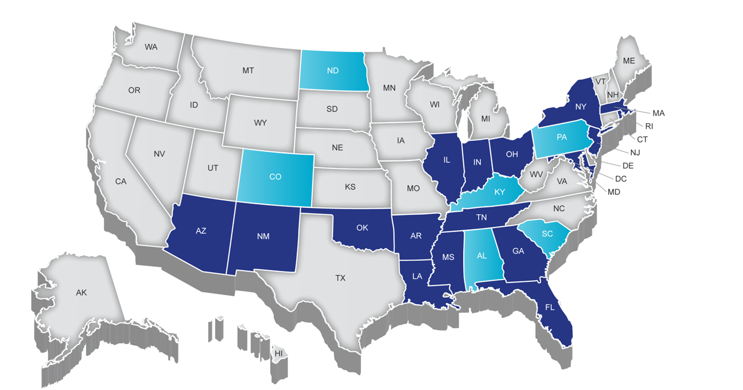

Partnership for Assessment of Readiness for College and Careers (PARCC)
Notes:
TALKING POINTS
PARCC is an alliance of 24 states, educating nearly 25 million students, that are working together to develop a common set of K-12 assessments in English and math anchored in what it takes to be ready for college and careers. PARCC is led by 18 governing board states (and D.C.) represented in Dark Blue.
Achieve is the project manager for PARCC, essentially serving as the staff for the consortium and coordinating the work. Collectively the PARCC states educate nearly 25 million students.
Governing States will pilot and field test the assessment system components over the next three years and administer the new assessment system during the 2014-15 school year. Governing States will use the results from the PARCC assessments in their state accountability systems
The chief state school officers of the Governing States serve on the PARCC Governing Board and make decisions on behalf of the Partnership on major policies and operational procedures
Participating States (light blue) provide staff to serve on PARCC’s design committees, working groups, and other task forces established by the Governing Board to conduct the work necessary to design and develop PARCC’s proposed assessment system. By 2014–15, any state that remains in PARCC must commit to statewide implementation and administration of the Partnership’s assessment system Any PARCC Participating State prepared to make the commitments and take on the responsibilities of a Governing State can become one
NOTES
Governing Board: Comprised of K-12 chiefs from Governing Board States
Technical Advisory Committee: Comprised of state/national assessment experts
Leadership Team: Comprised of delegates of K-12 chiefs from Governing Board States (e.g., Assoc. Supt for Curriculum, Assessment and/or Instruction)
ACCR: Comprised of national and state postsecondary leaders
Operational Working Groups: Comprised of national, state, and local experts and leaders in their specific areas of expertise

Slide 9
  PARCC Priorities
Create high-quality assessments
Build a pathway to college and career readiness for all students
Support educators in the classroom
Develop 21st century, technology-based assessments
Advance accountability at all levels
Build assessment system that is sustainable and affordable

Slide 10




PARCC Assessment Design
English Language Arts/Literacy and Mathematics, Grades 3-11
Optional Assessments/Flexible Administration
Diagnostic Assessment
Early indicator of student knowledge and skills to inform instruction, supports, and PD
Mid-Year Assessment
Performance-based
Emphasis on hard-to-measure standards
Potentially summative
Performance-Based
Assessment (PBA)
Extended tasks
Applications of concepts and skills
End-of-Year
Assessment
Innovative, computer-based items
Summative,
Required assessment
ELA - Speaking And Listening
Assessment
Locally scored
Non-summative, required
Interim, optional assessment
Notes:
TALKING POINTS
Graphic depiction of the assessment system. The system includes a suite of assessments and tools that, taken together, provide a more complete picture of student mastery of standards and progress throughout the year than is currently available on state assessments.
Considerations Leading to 2 optional assessments:
The cost of the assessments
Flexibility on when to administer the optional assessments
The amount of testing time needed to administer the assessments
Possible disruption to school schedules caused by through-course assessment preparation and administration
Constraints the distributed design might have on the flexibility of state and local educators to sequence instruction of the CCSS and to implement their own benchmark and formative assessment initiatives
The PARCC assessment system will:
Reflect the sophisticated knowledge and skills found in the English and math Common Core State Standards
Include a mix of item types (e.g., short answer, richer multiple choice, longer open response, performance-based)
Make significant use of technology
Include testing at key points throughout the year to give teachers, parents and students better information about whether students are on track or need additional support in particular areas
Taken together, the PARCC assessment components comprise a comprehensive system of assessments that will provide timely information to teachers throughout the year, and provide students with meaningful information about their progress toward college and career readiness

Slide 11
Claims Driving Design: ELA/Literacy
Students are on-track or ready for college and careers
Students build and present knowledge through research and the integration, comparison, and synthesis of ideas.
Reading Literature
Students read and comprehend a range of sufficiently complex texts independently
Students write effectively when using and/or analyzing sources.
Reading Informational Text
Vocabulary Interpretation and Use
Written Expression
Conventions and Knowledge of Language

Slide 12
ELA/Literacy Performance-Based Assessment
Grades 3-5
Research Simulation Task
Grades 6-8
Research Simulation Task
Literature Analysis Task
Grades 9-11
Research Simulation Task
Literary Analysis Task
Read one informational text, recount the key details and main idea (Grade 3) or write a summary (Grade 4/5)
Read three additional shorter texts, incorporate evidence from multiple texts in an analytic essay
6-9 reading comprehension questions
Read one short piece of literature and one extended piece of literature, answer reading comprehension questions
Read one informational text and write a summary distinct from personal opinions or judgments (Grade 6) or an objective summary (Grades 7/8)
6-9 reading comprehension questions
Read three additional shorter texts and incorporate evidence from multiple texts in an analytic essay
Write a narrative using one piece of literature as a stimulus
Write an analytic essay analyzing one or both texts
Engaging With Literature Task
Read one short piece of literature and one extended piece of literature; answer 4-6 reading comprehension questions
Write a narrative using one piece of literature as a stimulus
Write an analytic essay analyzing one or both of the texts
Read one informational text and write objective summary
Read three additional shorter texts and incorporate evidence from multiple texts in an analytic essay
6-9 reading comprehension questions
Read one short piece of literature and one extended piece of literature OR literary non-fiction
Answer 4-6 reading comprehension questions
Write a narrative using one piece of literature as a stimulus
Write an analytic essay analyzing one or both of the texts
Notes:
For all grade spans, the PBA will measure the Reading, Writing, and Research claims —all of which will contribute to the Master Claim

Slide 13
ELA/Literacy End-of-Year Assessment
Grades 3-11
Students read approximately 6 texts, including multimedia texts
The percentage of literature to informational/disciplinary literacy texts changes to reflect the shift in text emphasis in the standards
Students answer approximately 50 machine-scorable questions

Slide 14
Examples of what we ask students to write about from today’s tests
Example #1: Most people have a special activity or hobby that they enjoy. Some people collect things while others like to read or play games. What activity do you like to do? Write a composition describing what you enjoy doing. Explain why that activity is special to you. (Grade 3-5, New Jersey)
Example #2: Think about what a perfect day would be for you. What would you do? Where would you be? Who would be with you? In a well-developed composition, describe your perfect day and explain why it would be perfect for you. (Grade 7, Massachusetts)
Example #3: Who are our heroes? The media attention given to celebrities suggests that these people are today’s heroes. Yet ordinary people perform extraordinary acts of courage every day that go virtually unnoticed. Are these people the real heroes? Write an essay in which you define heroism and argue who you think our heroes really are–mass media stars, ordinary people, or maybe both. Be sure to use examples of specific celebrities, other people you have heard or read about, or people from your own community to support your position. (Grade 12, NAEP)

Slide 15
Claims Driving Design: Mathematics
Students are on-track or ready for college and careers
Students solve problems involving the major content for their grade level with connections to practices
Student demonstrate fluency in areas set forth in the Standards for Content in grades 3-6
Students solve problems involving the additional and supporting content for their grade level with connections to practices
Students express mathematical reasoning by constructing mathematical arguments and critiques
Students solve real world problems engaging particularly in the modeling practice

Slide 16
Mathematics Performance-Based Assessment
Grades 3-11
Focus will be on:
  Sub Claim A – major content
  Sub Claim C – reasoning
  Sub claim D – modeling/applications
PBA will be scored in time to be incorporated into the summative score
PARCC will release all PBA tasks along with item analysis and item-level scores

Slide 17
Mathematics End-of-Year Assessment
Grades 3-11
Will be comprised of computer‐based machine-scorable items.
Will focus on Sub Claims A (major content), B (supporting content), and E (fluency).
High school
States will select between traditional or integrated mathematics sequence; and each complete sequence will measure the full range of high school mathematics standards.
There is interest in creating a modularized version of the EOC exams, to allow greater customization of sequencing and pacing

Slide 18
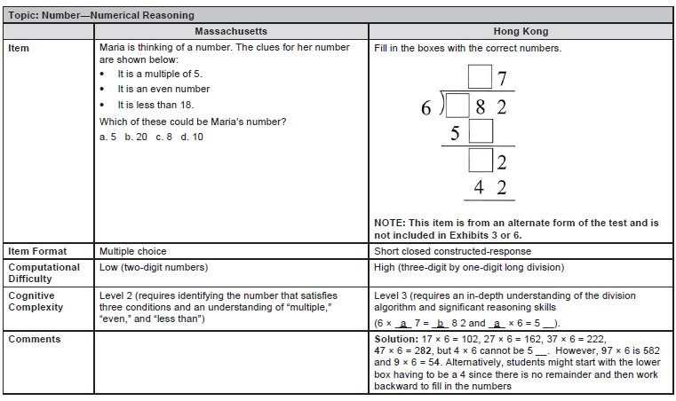
Higher Demands for the Same Content…

Slide 19
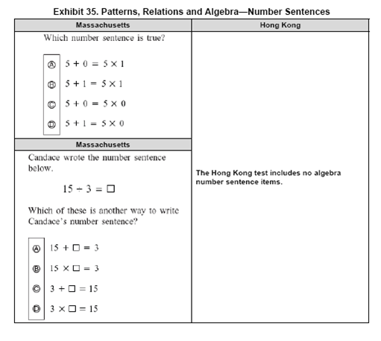
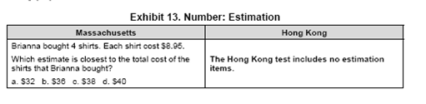
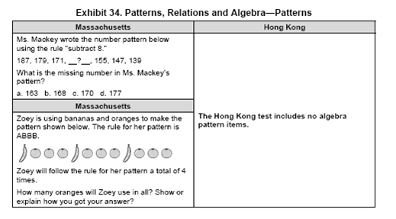
…With a Much Sharper Focus

Slide 20
PARCC Assessment System: Tools & Resources
Model Content Frameworks
Purpose: Identify the “big ideas” in the CCSS for each grade level; determine focus for assessment components; support development of blueprints; provide guidance to district- and school-level curriculum leaders in the development of aligned instructional materials
Model Instructional Units
Item and Task Prototypes
Purpose: Develop models of innovative, online-delivered items and rich performance tasks proposed for use in the PARCC assessments.
Purpose: Provide educators examples to concretely demonstrate a variety of means to implement the CCSS in the classroom; allow for the development and sharing of ideas for instructional implementation of the CCSS; encourage PARCC tool development for PARCC implementation and assessment transition
Audience: State and district curriculum directors (primary audience) ; teachers
Audience: Teachers; local and state curriculum directors
Audience: Broad audience: teachers, schools, districts, states (for CCSS implementation and PARCC assessment preparation)
Notes:
Model Content Frameworks released in early November. They are a living document, and we are collecting feedback from the field as they are implemented. Updated version based on this feedback in summer 2012.

Slide 21
Tools & Resources (continued)
Educator Leader Cadres
Purpose: Develop expertise on the CCSS and PARCC and help them to become state and peer leaders; Increase size and impact of state educator leader cadres; build and expand the number of educators who understand, support, and feel ownership for implementing the CCSS and PARCC Assessments
Professional Development Modules
College-Ready Tools
Purpose: Develop a set of college readiness tools aligned to the CCSS and PARCC assessments
Purpose: Develop professional development modules focused on assessments to help teachers, school and district leaders, and testing coordinators understand the new assessment system
Audience: State teams of K-12 teachers, school and district leaders, local and state curriculum directors, and postsecondary representatives
Audience: Teachers; school leaders; higher education
Audience: Teachers; instructional staff; school and district administrators

Slide 22
Tools & Resources (continued)
Diagnostic Assessments
Purpose: Develop diagnostic assessments in reading, writing, and mathematics for use by classroom teachers throughout the year to assess the extent to which students are “on track;” inform instruction throughout the school year
K-2 Formative Tools
Partnership Resource Center
Purpose: Provide an online warehouse of all the tools PARCC is developing and additional resources being developed independently and collectively by PARCC states and districts, and national organizations
Purpose: Measure student knowledge and skills across the full range of the CCSS; produce results that identify appropriate interventions or enrichment activities; support measures of growth
Audience: Teachers
Audience: Teachers; schools; districts; states
Audience: Broad audience: teachers; principals; students; parents; states; general public

Slide 23
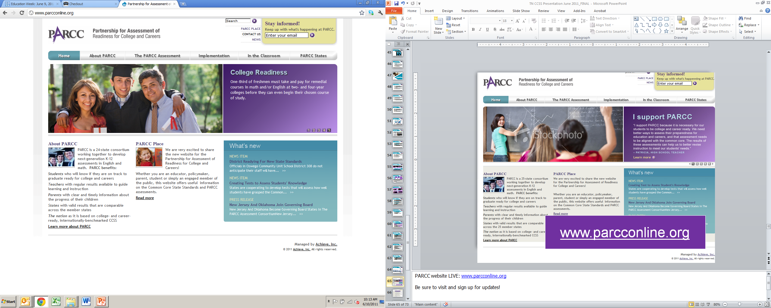
Sign up for PARCC Information at www.parcconline.org
Enter your email to receive the newsletter and updates.
Notes:
PARCC website launched in May 2011: www.parcconline.org
The website has five main sections:
About PARCC is where you can find information on PARCC’s goals, governance structure, key stakeholders, timeline, and challenges.
The PARCC Assessment is where you can find learn about PARCC’s major design and development work. It currently includes an overview of PARCC’s design elements and committees, and will later include the assessment blueprints and related materials, archived and new RFPs as they are released.
Implementation highlights on the major issues states, districts and/or schools need to address for a successful implementation of the Common Core State Standards and PARCC assessments, mainly from a policy and system-level perspective.
In the Classroom is dedicated to the classroom teacher and focuses on the instructional resources being developed through PARCC, as well as other instructional resources around the Common Core State Standards created by other organizations.
Each of the 25 PARCC States has a page where you can find information on the K-12 and postsecondary leaders managing the PARCC work in your state, as well as information on your state’s implementation of the on Common Core.
The website will also include a newsletter that will offer updates on PARCC-wide activities, as well as updates on developments within participating states. Enter your email address at the following link to sign up for the mailing list: http://visitor.r20.constantcontact.com/manage/optin?v=001l3cLBhqUqd_YxbR8iJo5AziRDp5GWas-1r7kq-6gLCb2G-6zCt9Yxw%3D%3D

